Slide 1
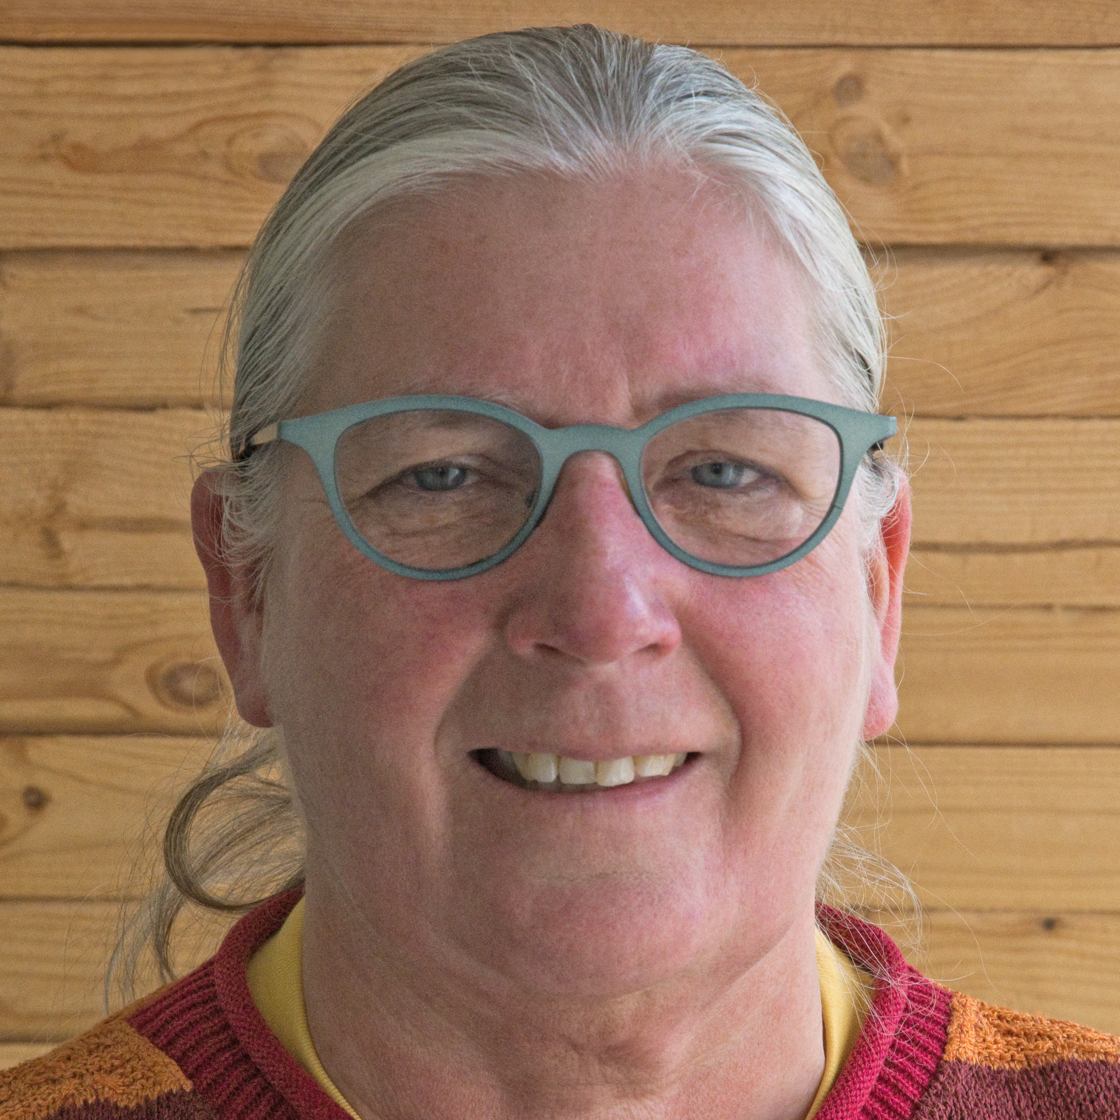
Module 3: Sustainability: global trends and co-responsibility in supply chains
Session 2:Improved sustainability practices in palm oil production
TITLE: Regenerative agriculture: challenges for the oil palm industry
Dr Maja Slingerland
Wageningen University, the Netherlands

Slide 2
What is regenerative agriculture?
Why is it needed in oil plan cultivation?
Which practices can be found oil palm cultivation?
Which challenges remain? The way forward.

Slide 3
What is regenerative agriculture?
What Is Regenerative Agriculture? A Review of Scholar and Practitioner Definitions Based on Processes and Outcomes
Peter Newton et al.
Front. Sustain. Food Syst. 4:577723.(2020)
DOI: 10.3389/fsufs.2020.577723
Regenerative Agriculture: An
agronomic perspective
Ken E Giller, et al. Outlook on Agriculture (2021), Vol. 50(1) 13–25; DOI: 10.1177/0030727021998063
Conclusion: multiple definitions, different manifestations in different contexts (no silver bullet), balance between environmental and agronomic outcome requires attention

Slide 4
Regenerative agriculture definitions
Practice based
Inclusion
use of cover crops (& rotation), retention of crop residues on fields, the integration of livestock, use of organic inputs, combine multiple crops and/or trees
Exclusion
no use of agrochemicals (fertilisers, pesticides, herbicides), reducing or eliminating tillage
Outcome based
to improve soil health, to sequester carbon, and to increase biodiversity
Conclusion: not much new, relations between practice and outcome require scientific attention, some exceptional claims are made

Slide 5
Which problems in oil palm cultivation are claimed to need regenerative agricultural practices?
Biodiversity loss: OP fields will always have lower biodiversity than forest but larger than annual crops. Biodiversity may decline over time.
Soil health: OP cultivation may lead to acidity, soil compaction, low carbon and nutrient status, and soil and water erosion
Carbon: OP fields will have lower above ground carbon stock than forests but higher than annual crops. Below ground carbon may decline over time.
System redesign & improved management may make a difference

Slide 6
Which examples of regenerative practices are already used within “conventional” oil palm cultivation?
What are considerations/challenges of proposed regenerative practices and expected outcomes in oil palm cultivation?

Slide 7
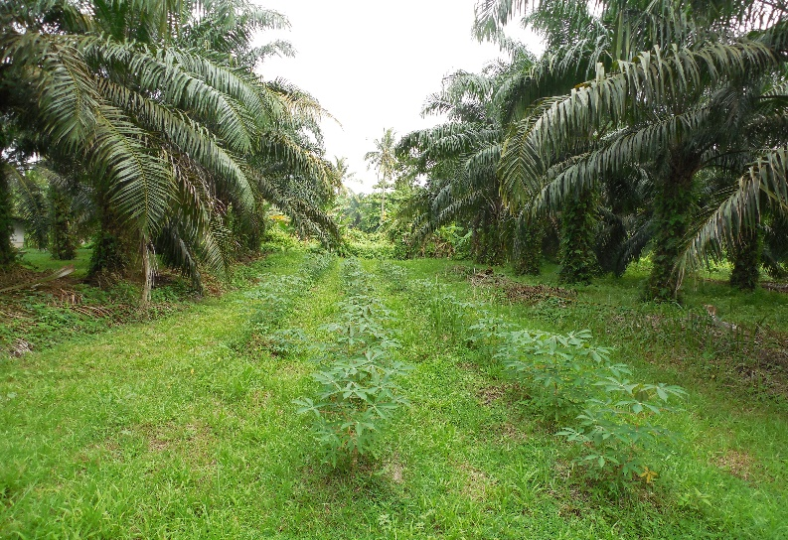
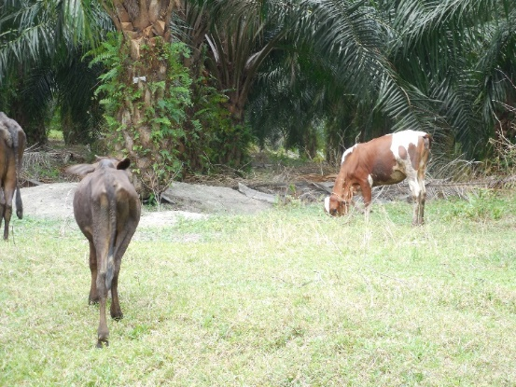
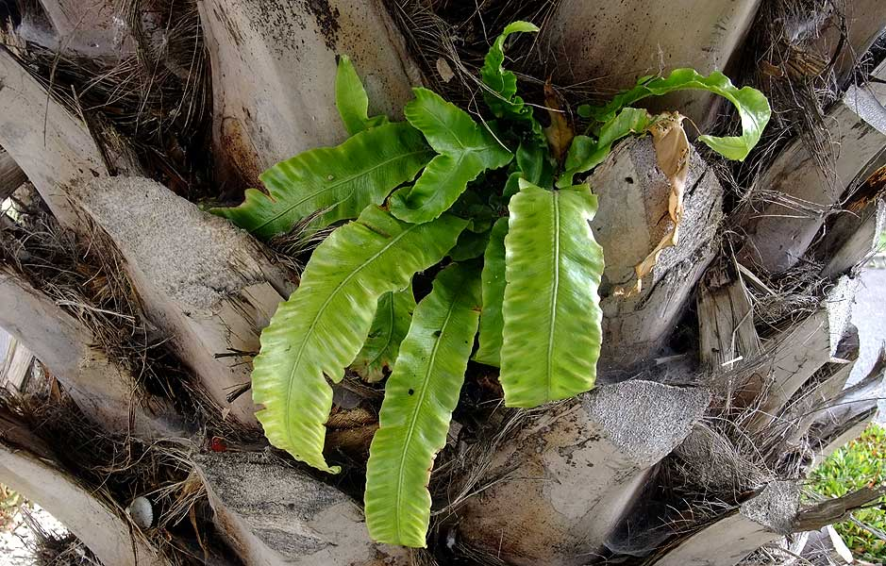
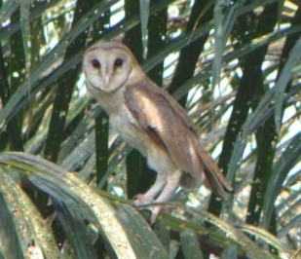
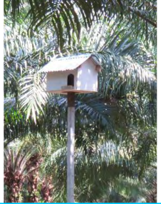
1. (Regenerative) practices to increase/facilitate biodiversity in Oil Palm fields
Malaysia: Biodiversity in oil palm is increased by alley cropping (Ashrafa et al, 2018) and grazing (Slade et al, 2014; Tohiran et al, 2017/19)
Indonesia: In oil palm there is extra above-ground soil biodiversity in axils of the trunk supporting e.g. ferns (Potapov et al, 2020)
Indonesia: Richness and composition of soil macrofauna in oil palm is higher when no herbicide is used (Ashton Butt et al. 2018)
Indonesia/Malaysia: reduced use of pesticides by using IPM such as barn owls to fight rats, reduced herbicide use through site specific weed control by mechanical weeding or grazing.

Slide 8
Considerations: are regenerative practices leading to more biodiversity??
Some studies show that management indeed increases biodiversity (inclusion)
Studies focus on one or few species (birds, dung beetles, ants, vegetation) or components (eg soil macrofauna) of the system.
Biodiversity consists of complex food webs/multi-trophic systems therefore potential positive/negative impacts on other species→ lack of good indicators
Impact (causal effect) of measured biodiversity on yield often not assessed
IPM and IWM are being applied to reduce pesticide/herbicide use (exclusion) yet biodiversity impacts rarely measured→ lack of good indicators

Slide 9
Challenges:
Impact of management on overall biodiversity still unknown (trade-offs?)
Positive impact of biodiversity on yield has not been established (yet) (outcome)
Lack of indicators that are accurate, easy and cheap to measure & monitor
Conclusion:
This makes regenerative practices for biodiversity less attractive to OP growers unless it reduces costs & health impacts to humans, or lead to premium prices
Recommendations:
More research needed on how to promote functional biodiversity that can play a role in pollination, hosting natural enemies for pests and diseases control, improve nutrient use efficiency, etc. positively affecting yield & into indicators for assessment and monitoring

Slide 10
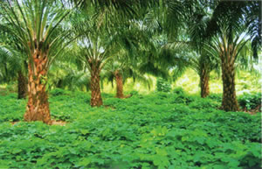
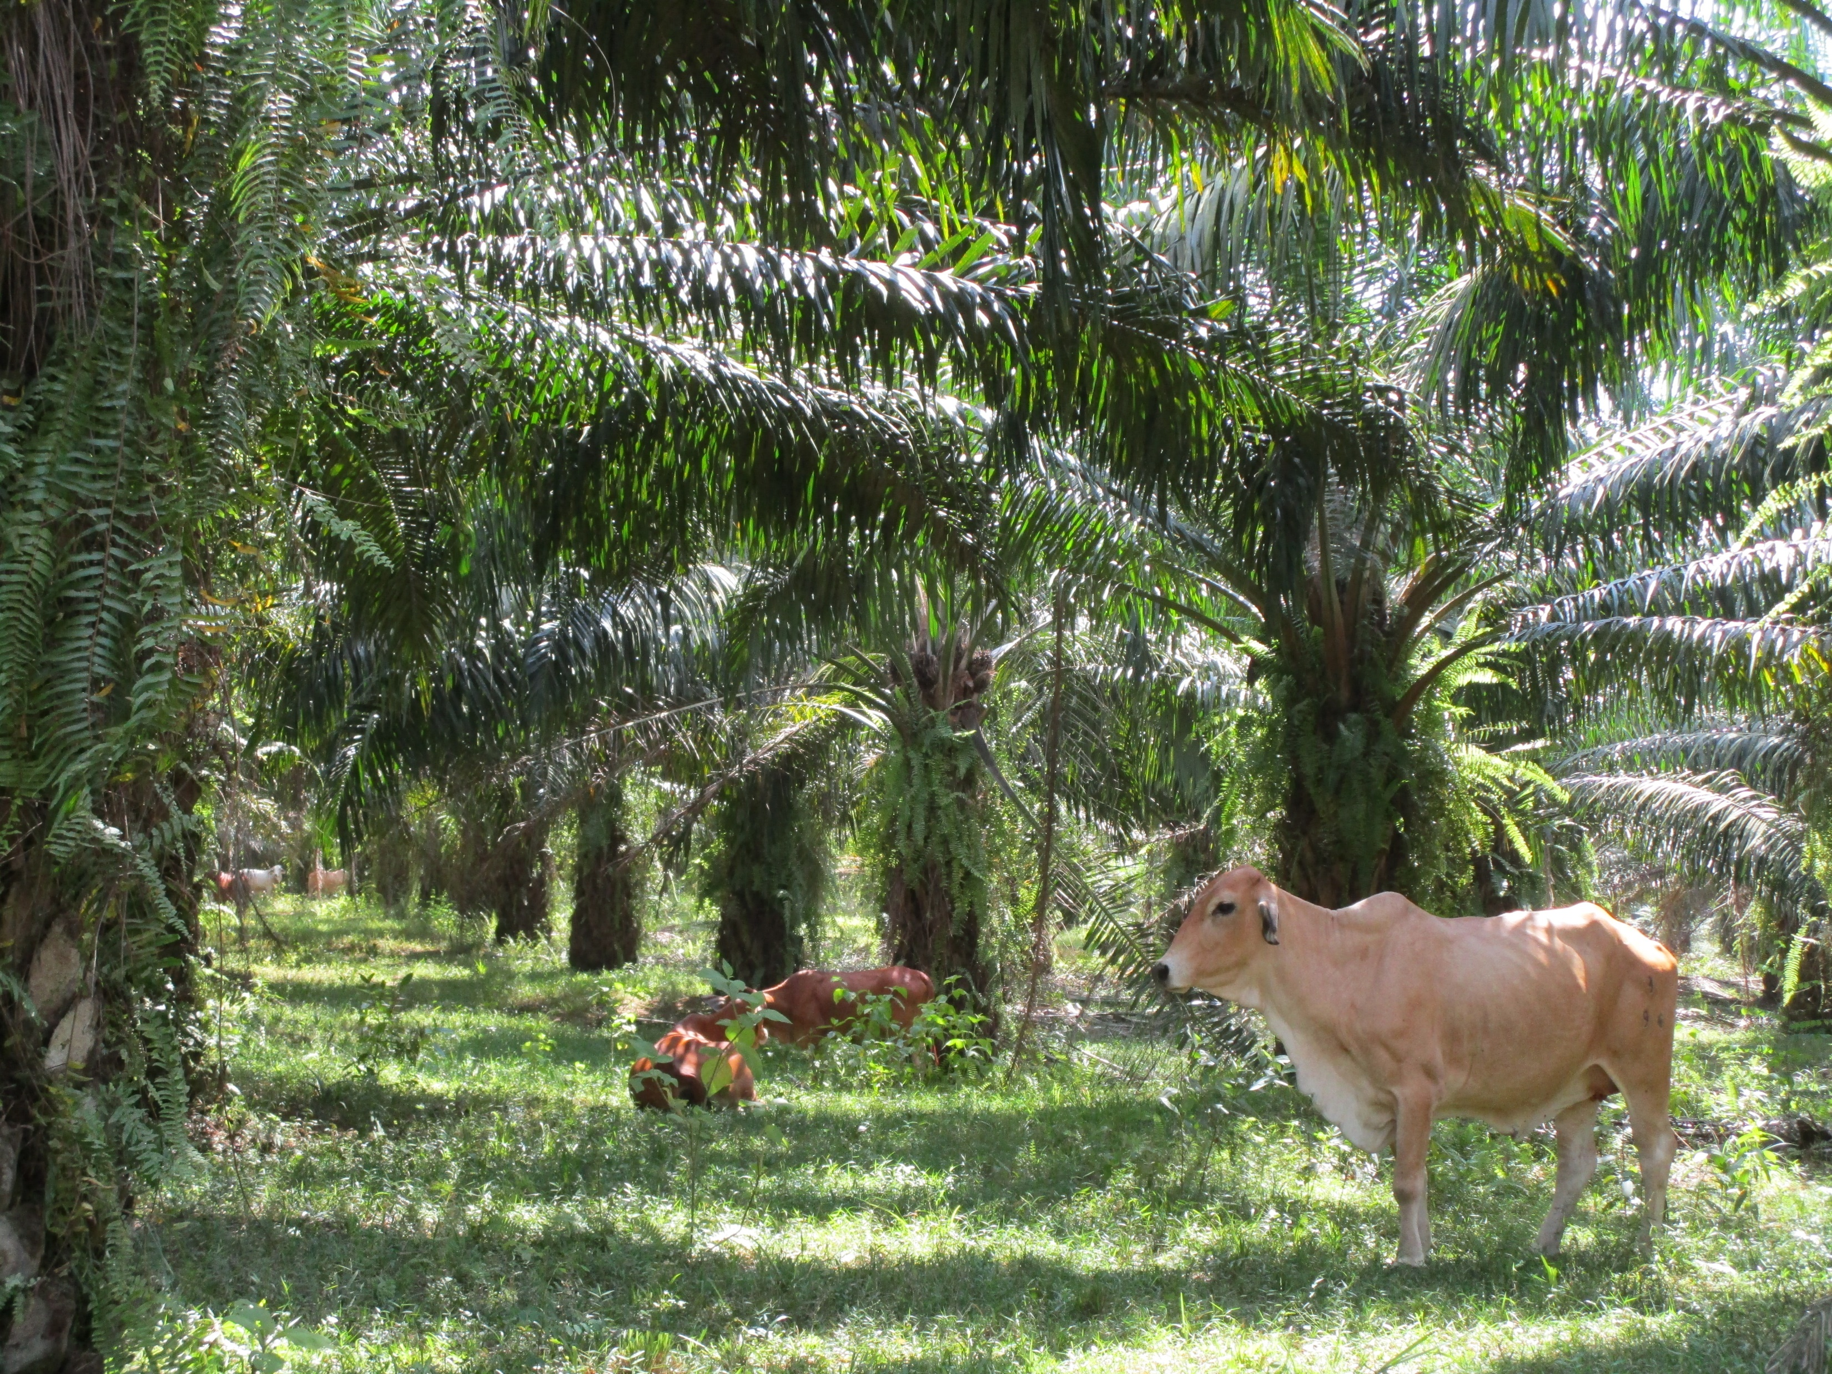
2. Regenerative practices to maintain/improve soil health
Maximize soil cover:
Leguminous cover crops at planting
Use of all OP residues as mulch (cover)
Weeding of circles & path, leaving soft weed cover
Effects:
prevent erosion and run off & add nutrients to the soil, reduce fertilizer needs
reduce soil compaction and acidification, add to soil carbon
increases infiltration e.g. under frond stacks (Comte et al, 2012)
Extra regenerative practice:
Integrating cattle grazing in oil palm to recycle nutrients → reduce
herbicide and fertilizer use

Slide 11
Consideration 1: Can recycling of residues fully replace inorganic fertilizer?? NO
Cumulation of residues (and nutrients) from FFB supplier fields to mill → replaces fertiliser in nucleus but increase fertilizer needs in fields of suppliers
Nutrients exported from the system in palm kernel meal
Nutrient losses when shells, (EFB) and MF are burned to fuel the mill
POME tends to stay at the mill
Options to better use nutrients from the OP biomass (W. Elbersen, 29sept Mod2 Ses4B )
POME, EFB and MF as feedstock for biodigester, biogas to fuel the mill. Digestate containing nutrients and recalcitrant carbon used for fertilisation & carbon sequestration
Boilerash returned to the field, making compost or biochar and returned to field??

Slide 12
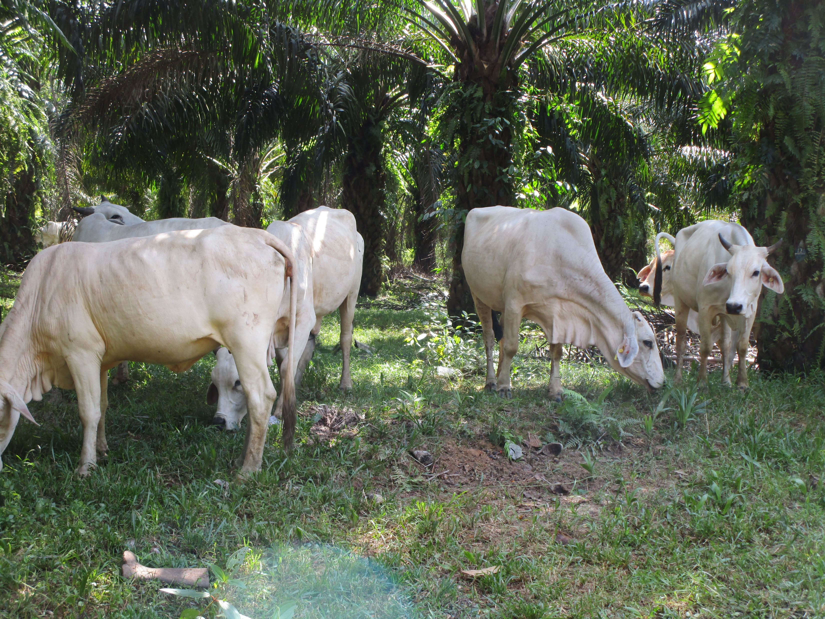
Consideration 2: Cattle grazing replaces herbicides but does it also replace fertilizer?
Excrements from grazing cattle contain the nutrients of the weeds, not adding nutrients to the system → not replacing fertiliser
When cattle is fed concentrate feed (palm kernel cake eg), these
nutrients will be added to the plantation through their dung/urine
Concentrate feed then replaces some fertilizer inputs.

Slide 13
Consideration 3: Soil fauna (microbes) as soil health indicator
Very difficult to measure accurately and therefore to monitor
Causal relation between soil fauna or microbial mass and increase in yield not (yet) assessed with scientific rigor. Many processes take place with potentially contradicting impacts.
Difficult for OP growers to justify & to apply regenerative practices to increase these aspects of soil health

Slide 14
Conclusions soil health
Several practices included in GAP could be called regenerative both by practice and by outcome. When properly implemented they can save herbicide, pesticide & fertilizer use and increase soil fauna.
Practices cannot fully replace fertilizer, nutrients have to come from somewhere (feed, smallholder fields) and losses occur (cake, fuel), external inputs needed
To make practices to increase soil helath attractive to OP producers, relations between soil health (eg soil fauna) and yield need to be established through robust scientific experiments, and soil health parameters needs to be easily mesured.

Slide 15
3 Regenerative practices to maintain or increase soil carbon
Current OP practices
no biomass burning at establishment
no cultivation on deep peat
some soil cover (cover crops, residues) to add SOM and prevent runoff of topsoil
Newly proposed practices
Organic amendments (dung, compost, biochar) to add to SOM, Soil Carbon, nutrients
Agroforestry to increase carbon sequestration (& reduce agro-chemical use)
No soil disturbance (eg during weeding)
NB For biochar see: N. Acelas, 29sept Mod2 Ses 4B

Slide 16
Consideration 1: Contribution of organic amendment to soil organic matter and soil carbon??
Break down & biomass needs
Ca.15% of C in plant biomass ends up as SOM, 85% is released as CO2 (Castellano, 2015, McGuire, 2018)
→ Huge amounts of biomass needed to increase SOM
Breakdown rates (biological activity & weathering) determined by temperature, moisture and oxygen levels.
Warm soils, if wet and aerated→ high rates of soil organic matter loss→ OP soil conditions & in peat
Tillage, by adding oxygen to the soil, promotes organic matter breakdown → OP generally no tillage
Without erosion, annual SOM losses range from 1-5% of total SOM (Magdoff and Weil, 2004).
Huge amounts of biomass needed to replenish SOM loss, esp. in high SOM soils. Recycling is not enough!!
Challenges:
(1)Where & how to produce those volumes of biomass??
(2)How to avoid that maintaining/increasing SOM and C in one place leads to SOM depletion elsewhere?

Slide 17
Consideration 2 Oil palm agroforestry
A few longterm experiments are in place→ many blogs, websites, videos, flyers to attract investors; so far only few scientific publications supporting assumptions/claims
Early observations
Claims mainly are about environment (biodiversity, soil health) & diversified revenues
Reported reduced use of agrochemicals & gain in carbon, due to biomass recycling→ plausible
Certain benefits described as “ potential” eg “ diversifying plant cover can make crops more resilient to pests and disease, thus requiring fewer pesticides and herbicides”. Is this effect actually measured??
Emphasizing more yield/palm, downplaying that less palms/ha may lower FFB yield/ha, but additional income available from other crops or (perhaps) carbon credits→ be clear that choices need to be made
Looking forward to (more) scientific evidence

Slide 18
Way forward (1) to implementers of regenerative practices and OP growers
Current practices in OP cultivation that are already considered regenerative need to be implemented, complemented with measures to cover losses & guarantee yield levels
Regenerative OP production needs to include yield as outcome parameter
In current agroforestry experiments rigorous measuring is needed at many levels to start building scientific evidence base on all aspects and to capture synergies and trade-offs.
Companies are encouraged to be part of the future by adopting experiments, and by funding research, to investigate the claims/assumptions, and share the outcomes

Slide 19
Way forward (2) Role of science
Establish causal relations (based in rigorous science) between
regenerative practices and environmental outcomes and
between environmental outcomes and yield
Develop indicators to assess & monitor the environmental outcomes easily, cheaply and accurately (eg for soil health, biodiversity) as intrinsic value but also mediating yield
Apply a systems approach as that allows to find synergies and trade-offs between desired outcomes and between outcomes at plot, farm and regional scale (eg include origin of OM)

Slide 20
Conclusion
Many GAPs in OP are already “regenerative”, → recommended in certification systems will allow for monitoring. These have to be implemented and complemented, as some trade-offs were overlooked and need attention.
The causal relations between newly proposed regenerative practices, environmental outcomes and yield are often unknown → yield must be one of the outcome parameters.
Several claims have not scientifically been proven and some may also be against current scientific knowledge about processes in soils and soil-plant relations (eg max SOM).
It is important that assumed relations are tested, that their results feed into scientific theories & that synergies and trade-offs between outcomes are established, so that in due time justified investments can be made and outcomes can be monitored.
OP companies, practitioners and science should go hand in hand

